Slide 1
TaskRoulette
Team MADNESS
COP 4331 – Spring 2014

Slide 2
This project is MADNESS!
Cody McMahon – Project Manager
Jessica Carter – Front-end/Back-end
Matthew McGivney – Database
Steven Lo – Testing
Gunnar Skotnicki – Back-end
TR

Slide 3

Tasks to Complete?
Sign in and add as many tasks as you want
Pick a task at random based on your available time
View the tasks you’ve created
Random another task at the click of a button
Log out and continue on with your day
TR
Notes:
Do you have a lot of things to get done? I know with finals coming up we’re all going to be strapped for time, so TaskRoulette is a perfect example of finding ways to manage your time efficiently. When a user accesses TaskRoulette through a web browser either through a desktop computer or mobile device they will be brought to a page to sign up and login. We only actively Chrome on both systems. When a user signs in for the first time they will be taken to the add task page where they can add tasks for later use. Whether it be something as trivial as washing the car or finishing a school project, when a user creates a task they will be able to specify the amount of time they expect the task to take. When a user has free time and doesn’t know what they want to accomplish, they can login to TaskRoulette and go to Get Task. When a user wishes to complete a task they will specify the amount of time they have available and then click the “get task” button. Once a task is completed it is deleted and the user is given the option to get another task with the same specifications.

Slide 4
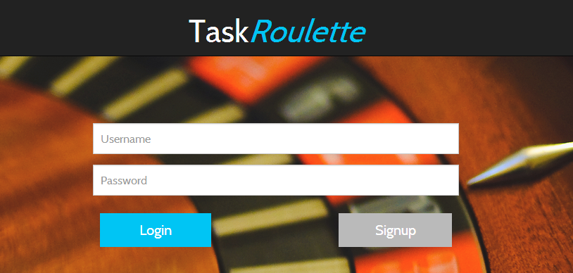
Demo
Create an account at http://www.taskroulette.biz/.
TR

Slide 5
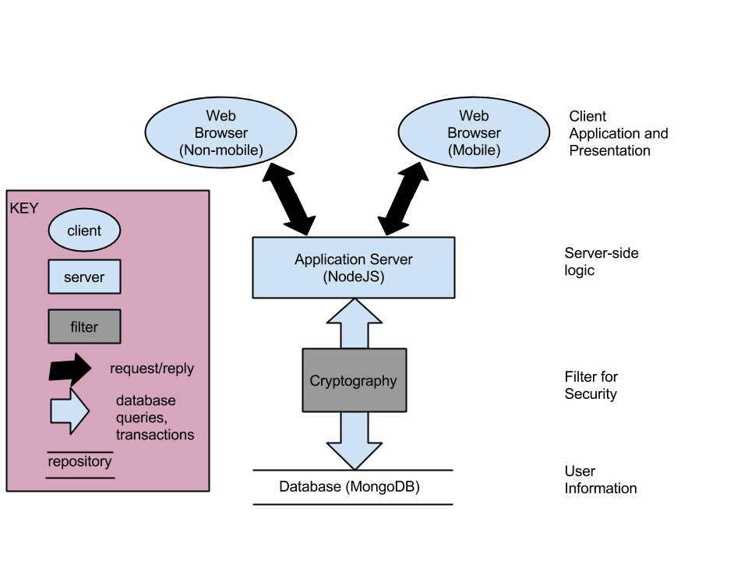
The High Level Architecture
TR

Slide 6
High Level Design
Access Task Roulette across different platforms
Bootstrap
Create an account and Add Tasks
MongoDB
Use the Website
HTML, CSS, Node.js, AngularJS, DigitalOcean server
TR

Slide 7
Issues
Using Node.js without the Express web-application framework
Authentic, Unique User Sessions
Getting a Random Task
Inexperience with Technologies (Node.js, AngularJS, MongoDB, CSS, HTML, Javascript)
TR
Notes:
We had a lot of problems with troubleshooting Node issues because everyone uses Express.We learned that people do not use Node by itself.
It was difficult to create unique user sessions. We needed to make sure users could only access information for their own account and didn’t have a way to break the site.
Getting a random task was difficult because we made a task array an attribute of a user in the database. Mongo has no real support for picking random elements of a single document, so this
issue was difficult to solve.
Also, we were all inexperienced with technologies we were using. One major issue some of us had was understanding Javascript’s asynchronous properties and how callback functions work.

Slide 8

Things to Consider in the future
Intricacies of web applications.
Unpredictable events for team members
Basic familiarity with technologies introduced
Limitations of technologies
TR
Notes:
Web Applications has a lot of layers and can be difficult to wrap your head around at times. Unexpected events can impact project productivity, such as a laptop screen dying.
Creating a new project with technologies you’ve never used can create some problems
Similar to the NodeJS/express problem, MongoRandom, Firefox problems 2awaw

Slide 9

Task Roulette Now...
All must have requirements were met
We will continue optional requirements in the future
Added Browser Support to Come
TR
Notes:
A statement of the quality of the final deliverable and your recommendations for the circumstances under which the delivered software should be used.
The site currently is in a basic structure form right now, with some crucial components not quite working as needed. Once these functions are appropriately fixed the integration and functionality of the site should be up to our spec. ^basic, needs trimming The site currently has problems with some major functional components, these are only some small bugs within the technology communications inhibiting functionality.
^better

Slide 10

Questions?
TR
Notes:
//nopeWhat should be on the final slide? It seems like there should be something after the Risk slide to end it.
Riddler question mark

